Slide 1
Group H: Steven Yu, Ryan Schwartz, Sydney Cady
TEA
RaspberryPi Setup: Python Complete
RaspberryPi Setup: C Complete
Implementation of self-timing within system: In Progress
Begin research into some benchmark systems

Slide 2
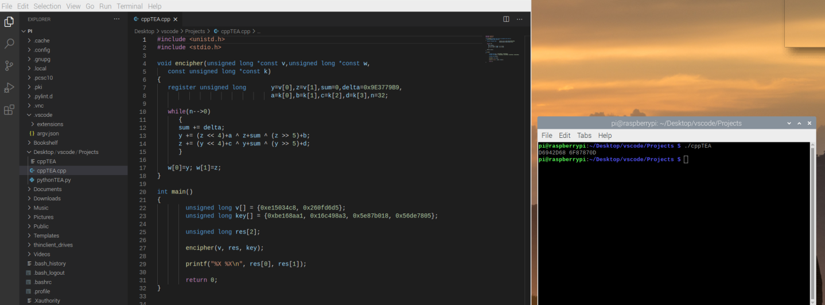
C++ Code:

Slide 3
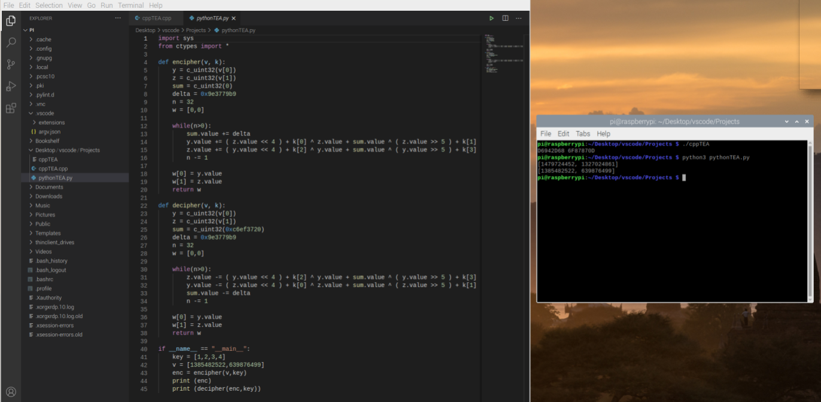
Python Code

Slide 4
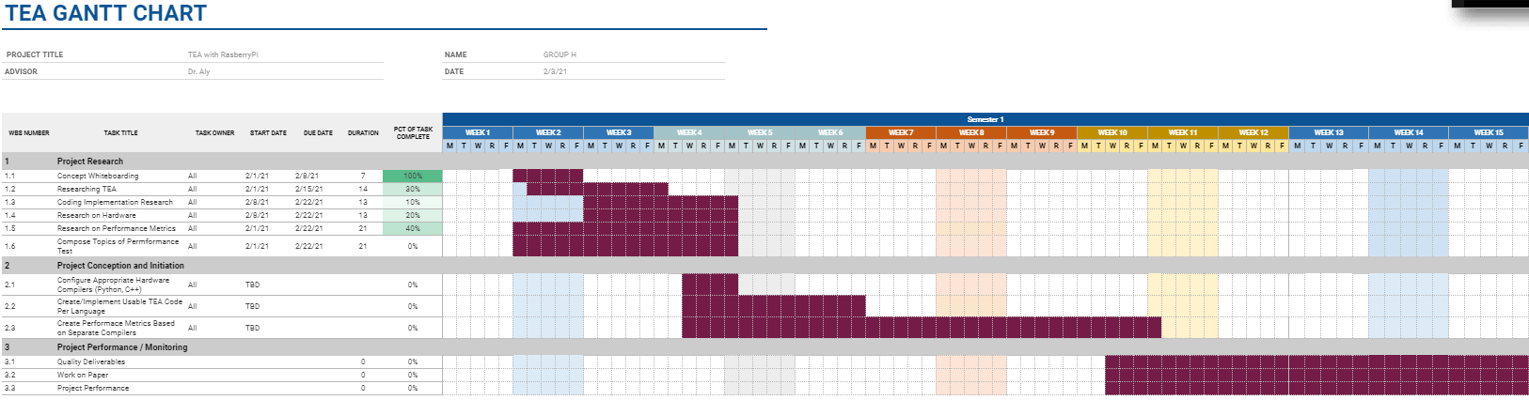
Gantt Chart: (zoomed out) - can show chart at request
https://docs.google.com/spreadsheets/d/1s_y6h7cKoFHyJrKPGLZ59DKch9dXiOWK4uzr-YfsOP8/edit?usp=sharing

Slide 5
To accomplish:
Metrics
Timing (Compile/Interpret)
Response Time
Possible Hardware
Python Interpreter Running Direct Python Code
Python Interpreter Running C++ API
GCC Compiler Running C++ Code
Forming questions:
What are some metrics you're looking for?/ Will the metrics above cover it enough?
What are some metric/benchmark systems that are compatible with RaspberryPi?
Testing/Begin forming paper/presentation
Notes:
CPI, MIPS, Mflip flops
Identify parts of code that are leaking the performance, room for improvement/redesign
Power, USB power meter for rasp, could use something cheap
-see how much data ran during the duration of power

Slide 6
Questions?

